Slide 1
Examining Job Automation in Wisconsin’s Workforce
Ryan Long
Regional Economist
WITS Ideas Forum
Department of Workforce Development
January 29, 2019
Crowne Plaza

Slide 2

Background
"Thou aimest high, Master Lee. Consider thou what the invention could do to my poor subjects. It would assuredly bring to them ruin by depriving them of employment, thus making them beggars.“
Queen Elizabeth I, 1589

Slide 3
Background cont’d
“We are being afflicted with a new disease of which some readers may not yet have heard the name, but of which they will hear a great deal in the years to come--namely, technological unemployment. This means unemployment due to our discovery of means of economising the use of labour outrunning the pace at which we can find new uses for labour.”
John Maynard Keynes, Economic Possibilities for our Grandchildren, 1930

Slide 4
Background cont’d
This discussion is about potential changes to the current labor market, NOT about job increases in other areas
Two researchers at Oxford estimated the probability that an occupation will become automatable
Three bottlenecks to automation
  Perception and Manipulation
  Creative Intelligence
  Social Intelligence
These bottlenecks corresponded with 9 different O*NET variables

Slide 5
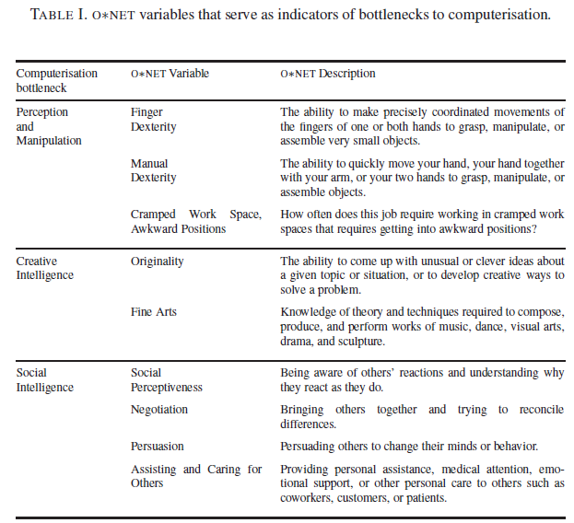
Background cont’d
Source: The Future of Employment: How Susceptible are Jobs to Computerisation, C.B. Frey and M.A. Osborne, September 17, 2013,
Oxford Martin School, University of Oxford

Slide 6
Methodology
Merged probabilities with OES data to calculate expected value of job automation
Expected Value = 0.23 × 4,280 = 984.4
SOC Code | Occupation | Probability | Employment | Expected Value
13-2051 | Financial Analysts | 0.23 | 4,280 | 984.4

Slide 7
Methodology cont’d
Within each group, the sum of the expected values was divided by total employment to generate the propensity for automation
Propensity = 6,701.2 / 14,410 = 46.5%
SOC Code | Occupation | Probability | Employment | Expected Value
31-1011 | Home Health Aides | 0.39 | 4,750 | 1,852.5
31-2021 | Physical Therapist Assistants | 0.018 | 1,640 | 29.5
31-9091 | Dental Assistants | 0.51 | 5,860 | 2,988.6
31-9094 | Medical Transcriptionists | 0.89 | 1,620 | 1,441.8
31-9095 | Pharmacy Aides | 0.72 | 540 | 388.8
 | Total |  | 14,410 | 6,701.2

Slide 8
Propensity for Automation by Occupational Group
Source: The Future of Employment: How Susceptible are Jobs to Computerisation, C.B. Frey and M.A. Osborne, September 17, 2013,
Oxford Martin School, University of Oxford; OES.

Slide 9
Propensity for Automation by Region
Source: The Future of Employment: How Susceptible are Jobs to Computerisation, C.B. Frey and M.A. Osborne, September 17, 2013,
Oxford Martin School, University of Oxford; OES.

Slide 10
Propensity for Automation by Typical Educational Requirements
Source: The Future of Employment: How Susceptible are Jobs to Computerisation, C.B. Frey and M.A. Osborne, September 17, 2013,
Oxford Martin School, University of Oxford; OES.

Slide 11
Propensity for Automation by Median Hourly Wage
Source: The Future of Employment: How Susceptible are Jobs to Computerisation, C.B. Frey and M.A. Osborne, September 17, 2013,
Oxford Martin School, University of Oxford; OES.

Slide 12
Takeaways
Automation exposure is anticipated to continue to increase inequality across different measures of “skill” (education and wages)
However, it might play a role in mitigating the quantity challenge
Adopting a flexible mindset can benefit labor market participants
Notes:
In regards to the last bullet point, I mean that both workers and employers can benefit by setting more adaptive expectations about the acquisition of skills before and during employment.
Given that the nature of skills is expected to evolve at an accelerated rate, workers should be comfortable with the idea that finishing your formal training (through school or otherwise) is not the end of acquiring relevant skills. Being willing to continuously adapt and learn new skills might be one of the most useful traits a job seeker/new employee can possess.
On the employer side, this might mean that job candidates with the right “hard skills” might be in limited supply. Getting employees “up to speed” might require more of a concerted effort from employers and other partners.

Slide 13
Questions?
Ryan Long
Regional Economist
920-448-5268
Ryan.Long@dwd.wisconsin.gov
http://dwd.wisconsin.gov

